Slide 1
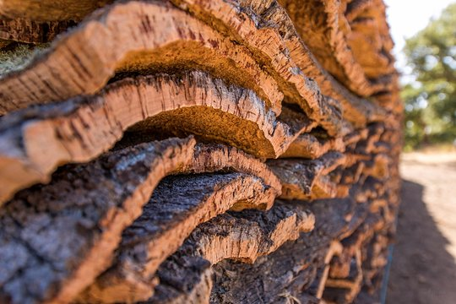
The Battle of Neighborhoods
Find the best spot for a modern company in London
April, 2020

Slide 2
CONTENT
01
03
05
04
Business Model and Background
Methodology
Conclusion
02
Results and Discussion
Data

Slide 3
01
BUSINESS MODEL AND BACKGROUND
London is known by its building rents. The following case study will cover this matter: the best spot for a modern company. Most of the companies rent buildings, it ends up being cheaper, faster and not a permanent decision which gives them flexibility. Although, this case is different and that's why it makes sense to involve a data scientist. Our manager wants to create from its beginning in London ... one that fulfill all their needs. The general location as you saw is already chosen. But there's still a huge job to be done in order to complete the process. Being this a permanent building for the factory, it will be time consuming and expensive, so let's take that into consideration when choosing the best spot. Because after that, there's no way back. They're counting on us.

Slide 4




01
BUSINESS MODEL AND BACKGROUND
SECURITY
ENVIRONMENT
POPULATION
The place should be safe.
The place should have an healthy environment
Not defined.

Slide 5




02
To report the most popular places in London
To undertand its boroughs and its population
DATA
FourSquare API
London Borough List
To access to criminality reports
As a base of the course
London recorded Crime
IBM Course

Slide 6

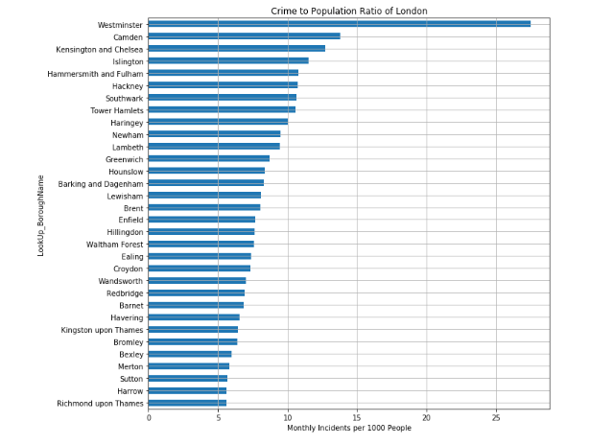
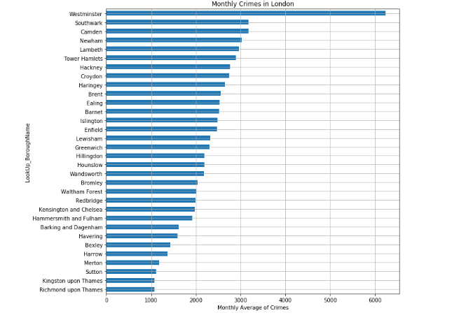
03
METHODOLOGY
Exploratory Data Analysis
Data visualization
In this one we can have an idea on which boroughs have the more crimes monthly in London. In this case, it would be Westminster, Southwark and Camden.
Another conclusion taken was about the ratio of crime to population in London. But the 2 first boroughs keep the same, which confirms our earlier conclusions.

Slide 7
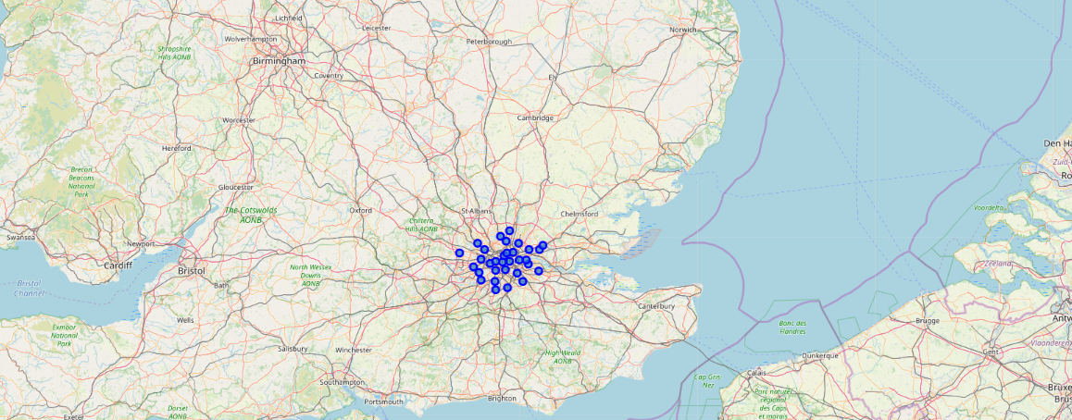
03
METHODOLOGY
Exploratory Data Analysis
Data visualization
Here we can check what was represented in previous graphs.

Slide 8

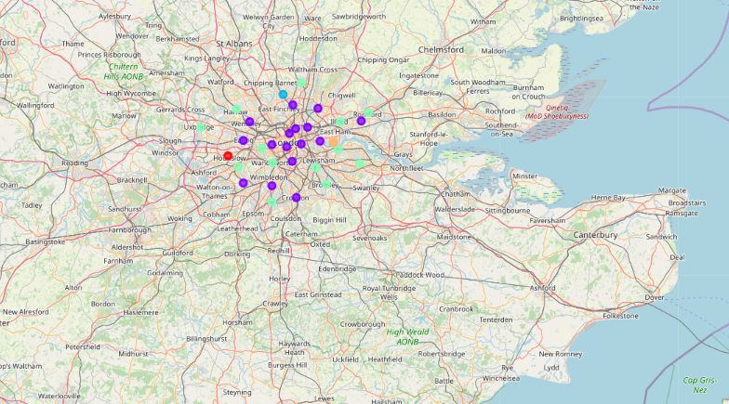
03
METHODOLOGY
Cluster Analysis
Different clusters represented by different colors.
Clusters created: Healthy area, Lively area, Busy Area, Quiet area and traveler area. Each one of them could bring benefits to the company

Slide 9
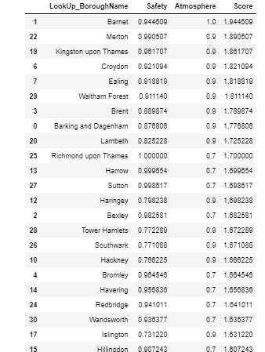
04
RESULTS AND DISCUSSIONS
Some analysis later it was possible to conclude we were able to discover the best neighborhood based on managers’ criteria.
Given the final score and the two main concerns of the manager, the location suggested is Barnet as follows.

Slide 10
04
CONCLUSION
Bernet is our suggestion!

